Slide 1
OS’24 Project
Milestone 1: PREPROCESSING
COMMAND PROMPT, SYSTEM CALLS, DYNAMIC ALLOCATOR & locks

Slide 2

Agenda
Logistics
Part 0: Prerequisites
Pointers
LISTs in FOS
Part 1: Play with Code!
Part 2: System Calls
Part 3: Dynamic Allocator
Part 4: Locks
Summary & Quick Guide
How to submit?

Slide 3
Logistics
Startup Code:
FOS_PROJECT_2024_template.zip
Follow these steps to import the project folder into the eclipse
Delivery Method: GOOGLE FORM
It’s FINAL delivery
MUST deliver the required tasks and ENSURE they’re worked correctly
Delivery Dates:
SAT of Week#5 (@11:59 PM isA)
Upload your code EARLY as NO EXCEPTION will be accepted.
Support:
Each team will be supported via their MENTOR (+Lecturer) during the published weekly office hours and/or contact method. [check this link]

Slide 4
Logistics
ADVICE#1: WORK AS A TEAM
Milestone 1 Functions:
Command Prompt ➔ 1 function
System Calls ➔ 2 requirements
Dynamic Allocator ➔ 5 functions + 1 test
Locks ➔ 5 functions
ADVICE#2: START immediately!
To have the chance to ask and to understand errors in your code in whatever you want during your mentor’s support before the deadline.
ADVICE#3: MUST read the ppt & doc CAREFULLY
Detailed steps
Helper ready made functions (appendices)
≈ 2~3 Functions/member
on 2 Weeks

Slide 5
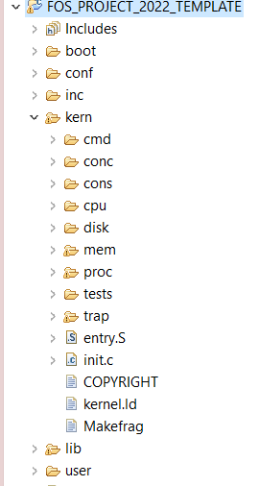




PROJECT BIG PICTURE
Cmd Prmpt
Locks
inc (.h)
lib (.c)
SysCalls
[MS1] Preprocessing
user
kern
[MS2] Memory
[MS3] CPU
SysCalls
Dyn Alloc

Slide 6

Pointers
PART0: PREREQUISITES

Slide 7
Memory and Pointers
Why we need pointers?! Pointers vs. Variables... Definition Data type & size Setting values Incrementing… Structure and accessing its members

Slide 8
Pointer vs Variables:
Definition
Pointers
Variables
char *ptr;
char x;

Slide 9

Pointer vs Variables:
Data type & Size
Pointers
Variables
char *ptr;
Data type:
Data type to point into it
Size of ptr (address):
4 Byte
Size of address bus of CPU (protected → 32-bit)
char x;
Data type:
Data type of variable itself
Size of x:
1 Byte → sizeof(char)

Slide 10

Pointer vs Variables:
Assigning value
Pointers
Variables
Assigning value:
char *c_ptr = 0x100;
//changes the pointed address
c_ptr = 0x50;
c_ptr = &x;
//changes the value within the pointed address
*c_ptr = 'A';
Assigning value:
char x = 10;
x = 50;
x = 'A';

Slide 11

Pointer vs Variables:
Incrementing
Pointers
Variables
increment:
char *c_ptr = 0x100;
c_ptr++; // ptr=0x101
int *i_ptr = 0x100;
i_ptr++; // ptr=0x104
Increases by the size of its type
increment:
char x = 10;
x++; // x=11
int x = 10;
x++; // x=11
Increases by 1

Slide 12

Pointer vs Variables:
Structure & its members
struct MyStruct {
int x, y;
char c;
char* c_ptr;
}
Pointers
Variables
Init. & Assign.:
Struct MyStruct *my_struct;
my_struct->x = 5;
my_struct->c = 'A';
(*my_struct).y = 10
Init. & Assign.:
Struct MyStruct my_struct;
my_struct.x = 5;
my_struct.c = 'A';

Slide 13


Pointer vs Variables:
Structure & its members
struct MyStruct {
int x, y;
char c;
char* c_ptr;
};
Pointers
Variables
Init. & Assign.:
Struct MyStruct *my_struct;
my_struct = 100;
my_struct++;
increases by size of struct
Init. & Assign.:
Struct MyStruct my_struct;
// ptr=113

Slide 14
LISTs in FOS
PART0: PREREQUISITES

Slide 15
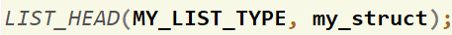
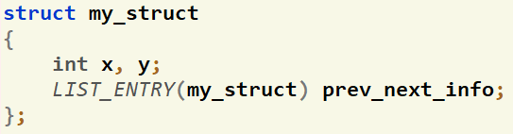
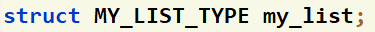

How to define LISTS in FOS?
To define a LIST that points to objects of type struct my_struct:
Create a list head that holds info about the list (size, head, tail).
LIST_HEAD([LIST_TYPE_DEF], [STRUCT NAME THAT WILL POINTS TO]);
Ex:
Add next and previous pointers to the struct
LIST_ENTRY([STRUCT NAME]) prev_next_info;
Ex:
Define your list
struct [LIST_TYPE_DEF] my_list
Ex:

Slide 16
How to use LISTS?
Set of helper ready made functions are available in Appendix II here
LIST_INIT(…)
LIST_INSERT_HEAD(…)
LIST_SIZE(…)
LIST_REMOVE(…)
…
IMPORTANT: you should pass the list to any of these functions by reference (i.e. Put & before the name of the list)

Slide 17
Agenda
Logistics
Part 0: Prerequisites
Pointers
LISTs in FOS
Part 1: Play with Code!
Part 2: System Calls
Part 3: Dynamic Allocator
Part 4: Locks
Summary & Quick Guide
How to submit?

Slide 18
Part1: Play with Code!
The objective of this part is to break the ice with the code and start navigate in it easily.
Assess: using pointers & lists
Required:
# | Function | File(s)
1 | process_command() | Essential declarations: kern/cmd/command_prompt.h, kern/cmd/commands.h, kern/cmd/commands.c Function definition TODO: kern/cmd/command_prompt.c

Slide 19
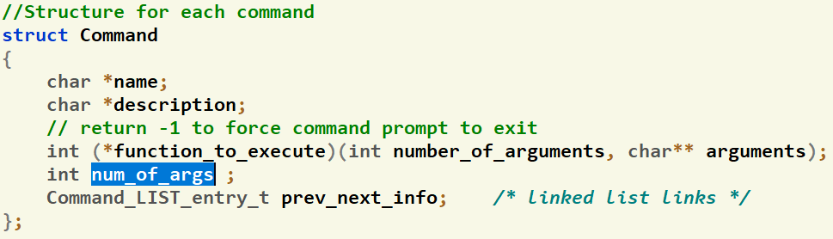
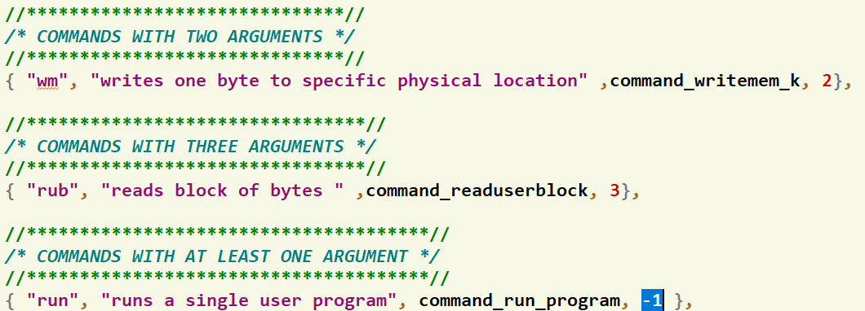

#1: process_command
Givens:
# of arguments per command
Linked list prev-next pointers
Initializations

Slide 20
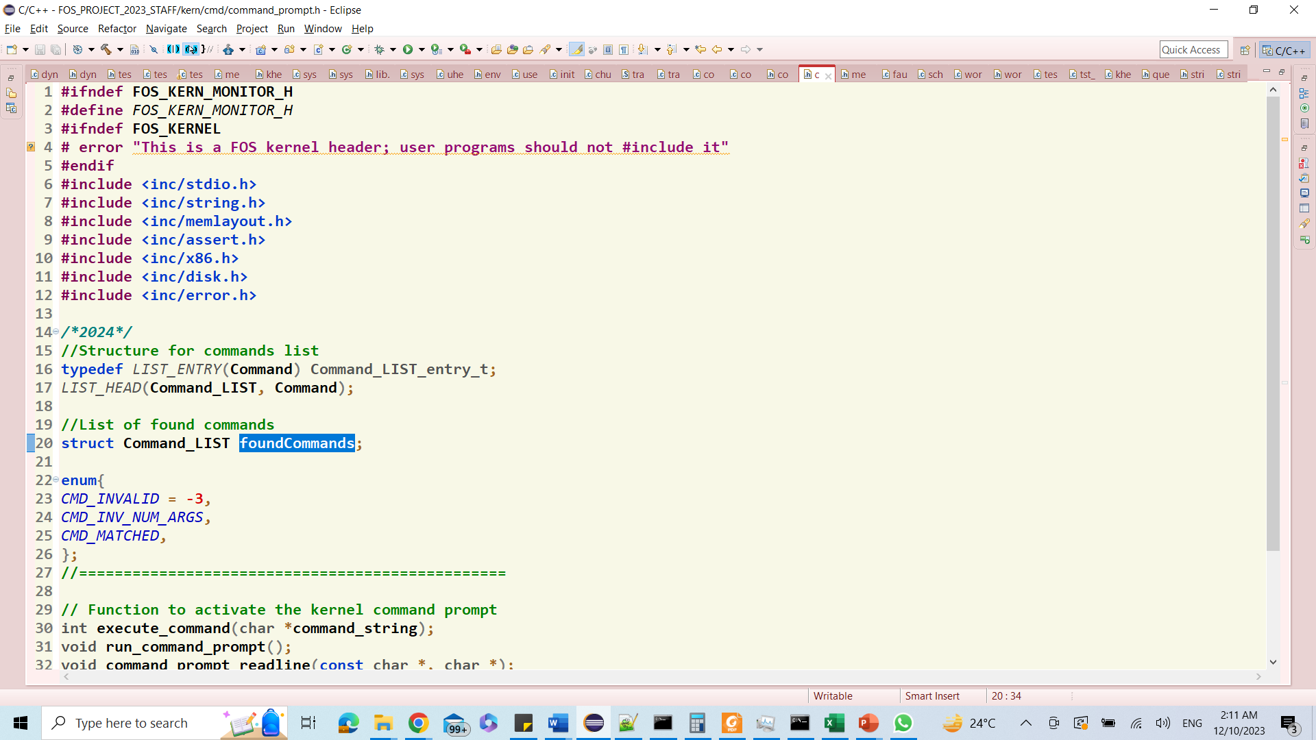
#1: process_command
Givens:
List of found commands (if any)
Hold objects from struct Command
Command Status

Slide 21
#1: process_command
Declaration:
int process_command(int number_of_arguments, char** arguments)
Description:
Status | Return | Content of List
1) invalid command (i.e. command chars are not exist/matched with any other command) | CMD_INVALID | Empty
2) command is found BUT with invalid number of arguments | CMD_INV_NUM_ARGS | Found command
3) command is not found BUT its chars are subsequence-matched with one or more commands | CMD_MATCHED | All matched commands
4) command is found with correct number of arguments | Index of the found command in “commands“ array | Empty

Slide 22
#1: process_command
Testing:
[UNSEEN] At your own…
Examples:
FOS> kernel_info ➔ should execute the kernel_info command
FOS> clk ➔ should print the commands that contains “clk” as subsequence
[1] nclock
[2] modifiedclock
[3] clock
FOS> wm ➔ should print invalid number of args
wm: invalid number of args.
FOS> smm ➔ invalid command
Unknown command “smm”
Helper Functions: refer to Appendix I

Slide 23
Agenda
Logistics
Part 0: Prerequisites
Pointers
LISTs in FOS
Part 1: Play with Code!
Part 2: System Calls
Part 3: Dynamic Allocator
Part 4: Locks
Summary & Quick Guide
How to submit?

Slide 24

Idea of System Calls
Where in Code?
lib/syscall.c
kern/trap/trap.c
kern/trap/syscall.c
inc/syscall.h
It’s OS procedure that executes privileged instructions (e.g., I/O); (API exported by kernel)
Causes a trap, which
Switch to the kernel mode
Look in Interrupt Descriptor Table (IDT)
Jumps to the syscall handler in the kernel.
The syscall handler do the following:
Save caller's state (CPU Reg’s) so it can restore control to the user process later.
Check the system call number (Typically, a number associated with each system call)
Call associated function that serve the given system call and pass to it the caller’s parameters
After finish, restore caller’s state (CPU Reg’s)
use iret instruction to return to user mode.
User Program
int main()
{
… ;
cprintf(…)
… ;
interrupt
?
ireturn
User Mode
How to pass params/return value from/to user to kernel or vice versa?
OS should verify the caller's parameters.
IDT
Kernel Mode
Read()
…
1
Syscall Handler
SYS_NO.?
Display(…)
…
2
RAM
Open(…)
…
3
CPU Reg’s
...
CPU Reg’s
Save
Caller State
Load
Print(…)
…
N

Slide 25

#2: Syscalls
Description:
Implement/handle THREE system calls.
Hint: have a look on any of the existing system calls to get the idea
Testing:
FOS> run tst_syscalls_1 10
Syscall in User Side (lib/syscall.c) | Corresponding Fun in Kernel Side (kern/trap/syscall.c) | Used In
void* sys_sbrk(int numOfPages) | void* sys_sbrk(int numOfPages) | MS#2
void sys_allocate_user_mem(uint32 virtual_address, uint32 size) | void sys_allocate_user_mem(uint32 virtual_address, uint32 size) | MS#2
void sys_free_user_mem(uint32 virtual_address, uint32 size) | void sys_free_user_mem(uint32 virtual_address, uint32 size) | MS#2

Slide 26
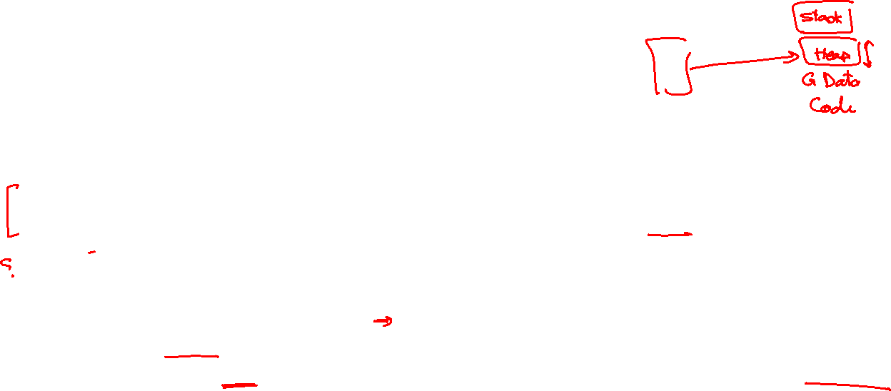
#3: Params Validation
Description:
At kernel side: need to validate any address (or range) that is passed from user to kernel to ensure that:
NOT null pointers,
NOT illegal pointers (e.g. pointing to kernel memory) (i.e. outside User Heap [USER_HEAP_START, USER_HEAP_MAX)),
NOT invalid pointers (e.g. pointing to unmapped memory),
Check only the first TWO cases. If violated, kernel should EXIT the user program by calling:
env_exit();
Third case cause a “page fault” that you can handle by modifying the code for page_fault() in MS#2.
This technique is normally faster because it takes advantage of the processor’s MMU, so it tends to be used in real kernels (including Linux).
Testing:
FOS> run tst_syscalls_2 10

Slide 27

Agenda
Logistics
Part 0: Prerequisites
Pointers
LISTs in FOS
Part 1: Play with Code!
Part 2: System Calls
Part 3: Dynamic Allocator
Part 4: Locks
Summary & Quick Guide
How to submit?

Slide 28

Objective
Handle memory blocks dynamically by using LISTS to allocate or free any required space in heap by either OS or any user program

Slide 29

Idea: Heap
a space of memory, continuous in the virtual address space, with three bounds:
The bottom of the heap.
The top of the heap, known as the break. The break can be changed using sbrk.
The hard limit of the heap, which the break can’t surpass.
Notes:
The break marks the end of the mapped memory space. It should be the first address past the end of the heap. Above the break lies virtual addresses which have not been mapped to physical addresses by the operating system. The user program should be able to write data starting at the start of the heap, up to and not including the segment break. You should implement sbrk as a new system call in FOS.

Slide 30

Idea: sbrk
void* sbrk(int numOfPages);
manipulate the position of the break
If it moves the segment break to increase the size of the heap, pages should be allocated and mapped as necessary.
More details about sbrk and its implementation will be in MS#2 isA

Slide 31


Idea: Explicit Free List
A simple memory allocator for the heap can be implemented using a doubly linked list on the free blocks.
Each block has the following metadata:
Header & Footer: two integers, each contains
Size: of the entire block (including the size of its meta data)
a/f: LSB indicate whether this block is allocated (1) or free (0)
Free block has the following extra metadata:
prev, next: Pointers to the adjacent FREE blocks
Allocated
Free
size
a
F
size
f
F
Padding (opt)
Payload
prev ptr ←
next ptr →
size
a
H
size
f
H
Size MUST be even… WHY?
Min block size is 16 B… WHY?

Slide 32






Idea: Explicit Free List
The heap dynamic allocator has the following special blocks:
BEG Block: an integer with size 0 and “a”llocate flag of 1
END Block: an integer with size 0 and “a”llocate flag of 1
Each free block has prev & next pointers to maintain the free list
These pointers point to the first location after the block header
The free list need to be sorted by addresses (to facilitate the first fit allocation strategy… see next)
0/1
16/1
16/1
50/1
50/1
28/0
$$↑$$
$$↓$$
28/0
26/1
26/1
46/0
$$↑$$
$$↓$$
46/0
16/1
16/1
16/0
$$↑$$
$$↓$$
16/0
18/1
18/1
38/0
$$↑$$
$$↓$$
38/0
0/1
freeBlockList

Slide 33
Idea: Allocate Block
Find the first block the fit the required size in addition to the size of its metadata (First Fit strategy)
If the found block is so large: split it into two; one to hold the required size, other to for residual free block.
If the found block is a bit larger, BUT not large enough for a new block
so, don’t split! there’ll be some unused space at the end of the allocated block (internal fragmentation).
Allocate 22 Byte
Allocate 16 Byte
0/1
16
28
30
16
16
16
18
0/1
50
28
26
46
38
freeBlockList

Slide 34

Idea: Free Block
Free the previously allocated block at the given virtual address
Free doesn’t release the memory back to OS; just indicates that block is available for future use.
Must coalesce (i.e. merge) consecutive free blocks upon freeing a block that is adjacent to other free block(s).
Free va4
Free va1
0/1
16
16
18
16
50
28
26
46
16
38
0/1
78
freeBlockList
va1
va2
va3
va4
va5

Slide 35

Idea: Pros/Cons
PROS:
Allocate is a LINEAR time in the number of free blocks instead of all blocks
Much faster when the dynamic allocator space is almost full
Coalesce (merge) is O(1)
Free has a BEST case of O(1) and a WORST case LINEAR time in the number of free blocks
CONS:
Extra space is required for the list links (2 extra words for each block)
Increase min block size ➔ more internal fragmentation
After running for a while, the space becomes highly fragmented, creating many small free regions. This results in low utilization.

Slide 36
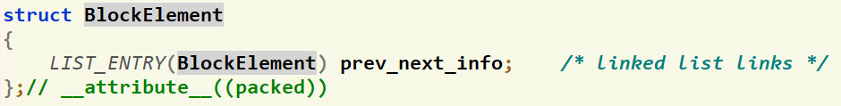

Code: Given Data Structures
Struct containing the prev-next pointer (to be used as list element)
List of Free Blocks that holds elements of type BlockElement

Slide 37

Code: Given Functions
Get size of the block at the given address
uint32 get_block_size(void* va);
Check the status of the block at the given address
int8 is_free_block(void* va);
Print the elements of a given block list
void print_blocks_list(struct MemBlock_LIST list);

Slide 38

#4: Initialize
void initialize_dynamic_allocator
(uint32 daStart, uint32 initSizeOfAllocatedSpace);
Description:
Initialize the dynamic allocator starting from the given address “daStart” with the given allocated space “initSizeOfAllocatedSpace”
The following items should be initialized here:
Free block list, BEG Block , END Block and the first free block
Testing: FOS> tst dynalloc init

Slide 39
#5: Set Block Data
void set_block_data(void* va, uint32 totalSize, bool isAllocated)
Description:
Set the header & footer of the block at the given va with the given info (totalSize & isAllocated)
Testing: at your own…
Hint: can use the given functions to check that the data is correctly set
size
a
F
va
size
a
H

Slide 40
#6: Allocate by First Fit
void *alloc_block_FF(uint32 required_size)
Description:
Find the first block the fit the required size in addition to the size of its metadata (First Fit)
If no sufficiently large free block is found, call sbrk to create more space on the heap.
If the found block is so large: split it into two; one to hold the required size, other to for residual free block.
If the found block is a bit larger, BUT not large enough for a new block
so, don’t split! there’ll be some unused space at the end of the allocated block (internal fragmentation).

Slide 41
#6: Allocate by First Fit
void *alloc_block_FF(uint32 required_size)
Return:
Make sure the returned pointer points to the beginning of the allocated space, not the header.
NULL if cannot allocate the new requested size (after sbrk)
NULL if the requested size is 0.
Testing: FOS> tst dynalloc allocff

Slide 42

#7: Free
void free_block(void* va)
Description:
Free the previously allocated block at the given address “va”
Free doesn’t release the memory back to OS; just indicates that block is available for future use.
Must coalesce (i.e. merge) consecutive free blocks upon freeing a block that is adjacent to other free block(s).
If va is NULL, do nothing
Testing: FOS> tst dynalloc freeff

Slide 43

#8: Reallocate by First Fit
void *realloc_block_FF(void* va, uint32 new_size)
Description:
Should resize the allocated block at va to new_size
If there’s sufficient free block in front of the allocated block ➔ resize it in the same place
Else, relocate it to a suitable free block (if any) using First Fit strategy
If no sufficiently large free block is found, use sbrk to create more space on the heap.
Make sure you handle the case where size is less than the original size.

Slide 44
#8: Reallocate by First Fit
void *realloc_block_FF(void* va, uint32 new_size)
Return:
Address of the reallocated block.
realloc_block_FF(va, 0) is equivalent to calling free(va) and returning NULL.
realloc_block_FF(NULL, n) is equivalent to calling alloc_FF(n) and return the allocated address.
realloc_block_FF(NULL, 0) is equivalent to calling alloc_FF(0), which should just return NULL.
Testing: FOS> tst dynalloc reallocff [PARTIAL TEST]

Slide 45
#9: Complete Test of Realloc
void test_realloc_block_FF()
Description:
The given test of realloc doesn’t handle all possible cases
It’s required to pick-up the missing cases and test them to ensure that your implementation is 100% correct.

Slide 46
BONUS: Allocate by Best Fit
void *alloc_block_BF(uint32 size)
Description:
Find the smallest block that fit the required size in addition to the size of its metadata (Best Fit strategy)
If no sufficiently large free block is found, use sbrk to create more space on the heap.
If the found block is so large: split it into two; one to hold the required size, other to for residual free block.
If the found block is a bit larger, BUT not large enough for a new block
so, don’t split! there’ll be some unused space at the end of the allocated block (internal fragmentation).

Slide 47
BONUS: Allocate by Best Fit
void *alloc_block_BF(uint32 size)
Return:
Make sure the returned pointer points to the beginning of the allocated space, not metadata header.
NULL if cannot allocate the new requested size
NULL if the requested size is 0.
Testing:
FOS> tst dynalloc allocbf
FOS> tst dynalloc freebf

Slide 48

Agenda
Logistics
Part 0: Prerequisites
Pointers
LISTs in FOS
Part 1: Play with Code!
Part 2: System Calls
Part 3: Dynamic Allocator
Part 4: Locks
Summary & Quick Guide
How to submit?

Slide 49

Objective
Implement a Sleep Lock inside the kernel to use it for protecting shared resources and/or blocking on I/O

Slide 50

Locks: Definition
Locks provide two atomic operations:
Lock.acquire() – wait until lock is free; then mark it as busy
After this returns, we say the calling thread holds the lock
Lock.release() – mark lock as free
Should only be called by a thread that currently holds the lock
After this returns, the calling thread no longer holds the lock
Negatives of interrupt-based implementation:
Can’t give lock implementation to users
Doesn’t work well on multiprocessor

Slide 51

Locks: Implementation
Exchange Instruction
Exchanges the contents of a register with a memory location.
Available in Intel IA-32 (Pentium) and IA-64 (Itanium)
The entire function is carried out atomically;
not subject to interruption (i.e. indivisible).
void exchange (int register, int memory)
{
int temp;
temp = memory;
memory = register;
register = temp;
}

Slide 52
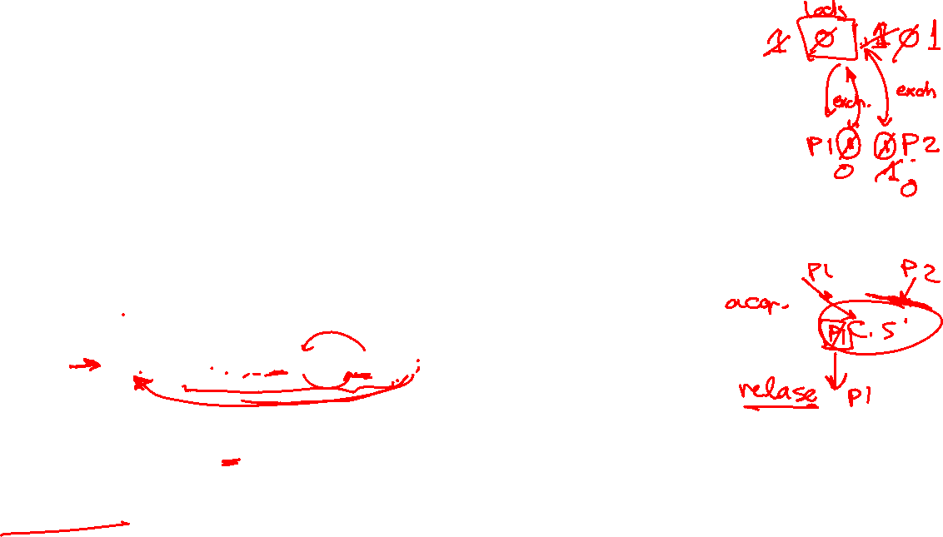
Locks: Implementation (SpinLock)
Simple lock that doesn’t require entry into the kernel:
// (Free) Can access this memory location from user space! int lock = 0; // Interface: acquire(&lock); // release(&lock);
acquire(int *thelock) {
int mykey = 1; while (xchg(thelock, mykey)); // Atomic operation! }
release(int *thelock) { *thelock = 0; // Atomic operation! }
Busy-Waiting: thread consumes cycles while waiting

Slide 53
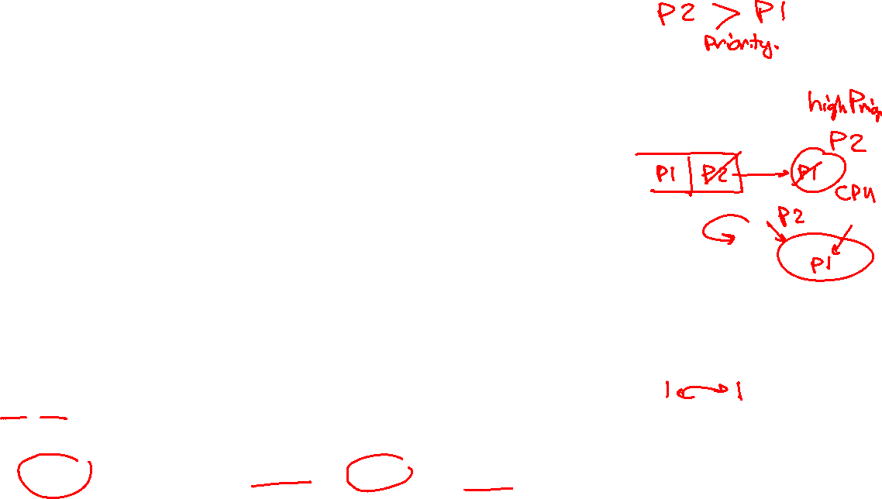
Locks: Implementation (SpinLock)
Positives
Machine can receive interrupts
User code can use this lock
Works on a multiprocessor
No System Calls at all
Negatives
This is very inefficient as thread will consume cycles waiting (busy-waiting)
Cache coherence issue in multi-cores
always read-write while waiting ➔ high traffic on cache buses to ensure data consistency
Priority Inversion: If busy-waiting thread has higher priority than thread holding lock ⇒ no progress!
Solution: disable the interrupt in acquire and enable it in release
Usually used for
short-time critical section

Slide 54

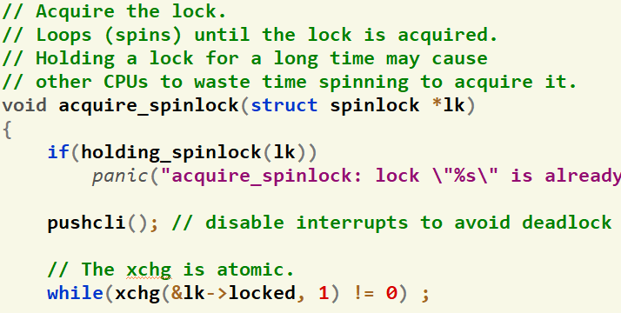
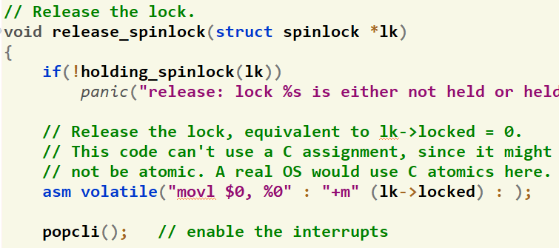
Locks: Implementation (SpinLock)

Slide 55

Locks: Implementation (SleepLock)
Idea: only busy-wait to atomically check lock value
Note: unlike previous solution, the critical section is very short
Note: sleep has to be sure to reset the guard variable
Why can’t we do it just before or just after the sleep?
SpinLock guard = 0;
int mylock = FREE;
acquire(int *thelock) {
acquire_spinlock(&guard)
while (*thelock == BUSY) {
put thread on wait queue;
go to sleep()
// guard == 1 on wakeup!
}
*thelock = BUSY;
release_spinlock(&guard);
} }
release(int *thelock) {
acquire_spinlock(&guard)
if anyone on wait queue {
wake-up ALL blocked processes
}
*thelock = FREE;
release_spinlock(&guard); }
& release guard

Slide 56

Locks: Implementation (SleepLock)
What about release guard when going to sleep?
Before Putting thread on the wait queue?
Release can check the queue and not wake up thread ➔ missing wake-up
After putting the thread on the wait queue
Release puts the thread on the ready queue, but the thread still thinks it needs to go to sleep
Misses wakeup and still holds lock (deadlock!)
Want to put it after sleep(). But – how?
In Sleep: Protect the process queue(s) then release the guard. This ensures no missing wake-up even if release is called.
SpinLock guard = 0;
int mylock = FREE;
acquire(int *thelock) {
acquire_spinlock(&guard)
while (*thelock == BUSY) {
put thread on wait queue;
go to sleep()
// guard == 1 on wakeup!
}
*thelock = BUSY;
release_spinlock(&guard);
} }
Release Position
Release Position
Release Position
& release guard

Slide 57
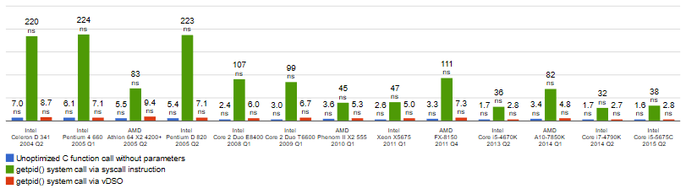
Locks: Implementation (SleepLock)
Positives
Machine can receive interrupts
User code can use this lock
Works on a multiprocessor
Solve Busy-Waiting
Negatives
Need system call in sleep() & wakeup()
Min System call ~ 25x cost of function call
Usually used for
long-time critical section

Slide 58
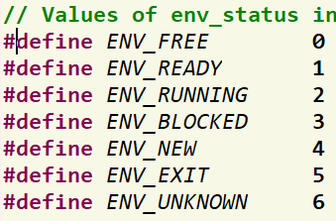
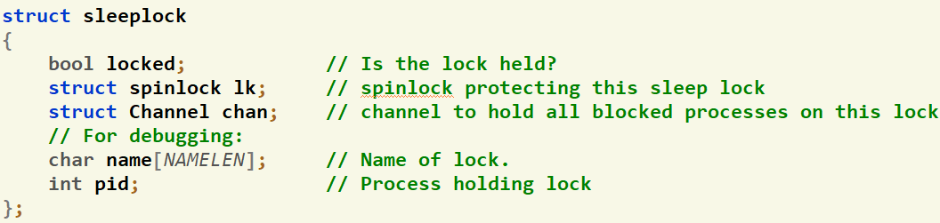
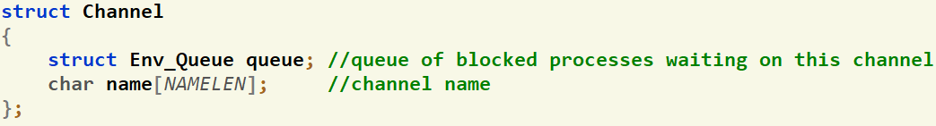
Code: Given Data Structures
Process Status
(inc/environment_definitions.h)
Complete implementation of SpinLock (kern/conc/spinlock.h & .c)
SpinLock to protect ANY process queue (kern/cpu/sched.h)
Struct declaration of the SleepLock (kern/conc/sleeplock.h)
Struct declaration of the Channel (kern/conc/channel.h)
ProcessQueues.qlock

Slide 59
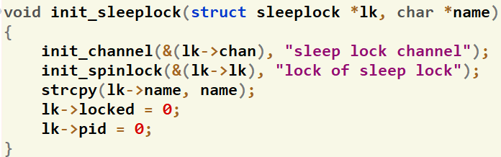
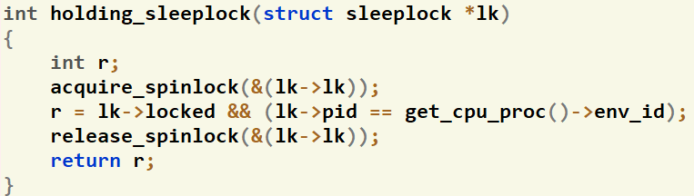
Code: Given Functions
Initialize the SleepLock (kern/conc/sleeplock.c)
Check whether the lock is held or not? (kern/conc/sleeplock.c)

Slide 60
Code: Given Functions
Get the current running process (kern/proc/user_environment..c)
Insert a process into the ready queue (kern/cpu/sched_helpers.c)
Queues functions: (kern/cpu/sched_helpers.c)
Invoke the scheduler to context switch into the next ready queue (if any) (kern/proc/user_environment..c)
struct Env* get_cpu_proc();
void sched_insert_ready0(struct Env* p);
int queue_size(struct Env_Queue* queue);
void enqueue(struct Env_Queue* queue, struct Env* env);
struct Env* dequeue(struct Env_Queue* queue);
void sched();

Slide 61
#10: Sleep on Channel
void sleep(struct Channel *chan, struct spinlock* lk);
Description:
Should block the current running process on the given chan and schedule a next ready one
It should release the given lk before being blocked so that other process(es) can use it
It should reacquire the given lk again when awakened.
GENERAL NOTE: make sure to protect any process queue using the suitable lock

Slide 62
#11: Wake-up ONE in Channel
void wakeup_one(struct Channel *chan)
Description:
Should wake-up ONE blocked process in the given chan and change it to ready
GENERAL NOTE: make sure to protect any process queue using the suitable lock

Slide 63
#12: Wake-up ALL in Channel
void wakeup_all(struct Channel *chan)
Description:
Should wake-up ALL blocked process(es) in the given chan and change them to ready
GENERAL NOTE: make sure to protect any process queue using the suitable lock

Slide 64
#13: Acquire Sleep Lock
void acquire_sleeplock(struct sleeplock *lk)
Description:
Should acquire the given sleep lock lk
If successfully acquired, continue
If failed, block the process on the corresponding channel
Refer to the previously explained pseudocode
GENERAL NOTE: make sure to protect any process queue using the suitable lock

Slide 65
#14: Release Sleep Lock
void release_sleeplock(struct sleeplock *lk)
Description:
Should release the given sleep lock lk by waken-up ALL blocked processes on it
Refer to the previously explained pseudocode
GENERAL NOTE: make sure to protect any process queue using the suitable lock

Slide 66
Agenda
Logistics
Part 0: Prerequisites
Pointers
LISTs in FOS
Part 1: Play with Code!
Part 2: System Calls
Part 3: Dynamic Allocator
Part 4: Locks
Summary & Quick Guide
How to submit?

Slide 67
Summary
"Congratulations!! test [TEST NAME] completed successfully.”
To ensure the test success, a congratulations message like this MUST appear without any ERROR messages or PANICs.
Module | Function | Diff. | Testing | Files
Play w/ Code | process_command | L2 | UNSEEN – Test at your own | kern/cmd/command_prompt.c
System Calls | 3 system calls | L2 | FOS> run tst_syscalls_1 10 | lib/syscall.c, kern/trap/trap.c, kern/trap/syscall.c, inc/syscall.h
 | params validation | L1 | FOS> run tst_syscalls_2 10
Dynamic Allocator | initialize | L1 | FOS> tst dynalloc init | lib/dynamic_allocator.c
 | set_block_data | L1 | UNSEEN – Test at your own
 | alloc_block_FF | L2 | FOS> tst dynalloc allocff
 | free_block | L3 | FOS> tst dynalloc freeff
 | realloc_block_FF | L3 | FOS> tst dynalloc reallocff (Partial)
 | test_realloc_block_FF | L2 | UNSEEN – Test at your own | kern/tests/test_dynamic_allocator.c
 | (+) alloc_block_BF | L2 | FOS> tst dynalloc allocbf FOS> tst dynalloc freebf | lib/dynamic_allocator.c
Sleep Lock | Sleep | L2 | TBD | kern/conc/channel.c
 | Wakeup One | L1 | TBD | kern/conc/channel.c
 | Wakeup ALL | L1 | TBD | kern/conc/channel.c
 | Acquire | L1 | TBD | kern/conc/sleeplock.c
 | Release | L1 | TBD | kern/conc/sleeplock.c

Slide 68
Startup Code
FOS_PROJECT_2024_Template.Zip
Follow these steps to import the project folder into the eclipse

Slide 69
Helper Videos
How to import a new project into eclipse? [link]
Debugging:
Debug via breakpoints (ECLIPSE) [link]
Debug via printing [link: 1st minute]
Locate the line causing exception via disassembly [link]

Slide 70
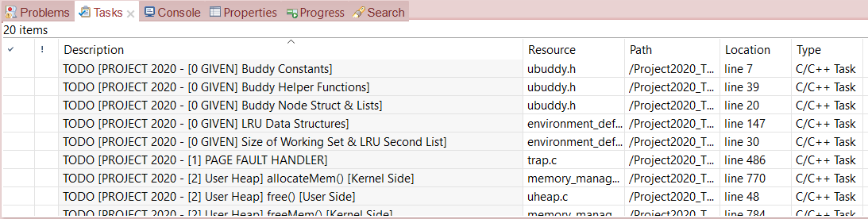
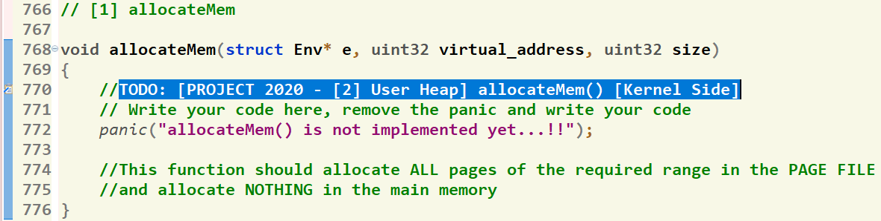
Where should I write the Code?
There’re shortcut links that direct you to the function definition
[1] Click on “Tasks” Tab
[2] Double Click on the required function
GIVEN
REQUIRED
[3] Function body, at which you should write the code
70

Slide 71
Helper Ready Made Functions
Set of ready-made LIST and string functions are available to help you when writing your solution.
Detailed description can be found in this document.

Slide 72
Agenda
Logistics
Part 0: Prerequisites
Pointers
LISTs in FOS
Part 1: Play with Code!
Part 2: System Calls
Part 3: Dynamic Allocator
Part 4: Locks
Summary & Quick Guide
How to submit?

Slide 73
Submission Rules
Read the following instructions as the code correction is done AUTOMATICALLY. Any violation in these rules will lead to 0 and, in this case, nothing could be happened.
First ensure the following that (READ CAREFULLY):
You tested each function in a FRESH RUN and a congratulations message have been appeared.
NO CODE with errors WILL BE CORRECTED. So, CLEAN & RUN your project several times before your submission.
You submitted BEFORE the deadline by several hours to AVOID any internet problems.
DEADLINE: SAT of Week #5 (26/10 @11:59 PM)
NO DELAYED submissions WILL BE ACCEPTED.
ONLY ONE person from the team shall submit the code.
The TEAM # MUST BE CORRECT.
DON’T take the FORM LINK FROM ANYONE. OPEN the form from its LINK ONLY. Otherwise, your submission is AUTOMATICALLY CANCELLED by GOOGLE.
You MUST RECEIVE A MAIL FROM GOOGLE with your submission after clicking submit. If nothing received, re-submit again to consider your submission.

Slide 74
Submission Steps
STEPS to SUBMIT:
Step 1: Clean & run your code the last time to ensure that there are any errors.
Step 2: Create a new folder and name it by your team number ONLY. Example 1 or 95. [ANY extra chars will lead to 0].
Step 3: DELETE the “obj” folder from the “FOS_PROJECT_2024_Template”
Step 4: PASTE the “FOS_PROJECT_2024_Template” in the folder created in step #2.
Step 5: Zip the created new folder. Its name shall be like [num of your team.zip]. [ANY extra chars will lead to ZERO].
Step 6: Open the form from HERE.
Step 7: Fill your team’s info .. Any wrong information will cancel your submission, revise them well.
Step 8: Upload the zipped folder in step 5 to the form in its field.
Step 9: MUST RECEIVE A MAIL from GOOGLE with your submission, otherwise re-submit again.

Slide 75
Thank you for your care…
Enjoy making your own FOS ☺

